Slide 1
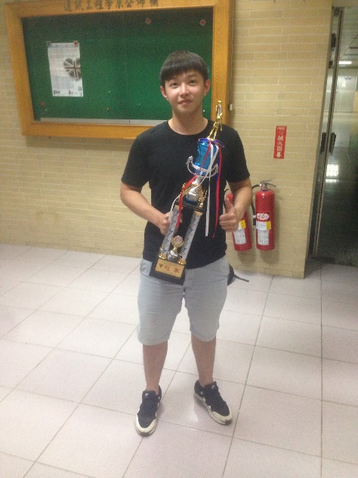
Digital Image Processing HW#3
Instructor: Chih-Wei Tang (唐之瑋)
TA: Ching Huang (黃竫)
Visual Communications Lab
Dep. of Communication Engineering
National Central University
Date: 2017/12/01

Slide 2
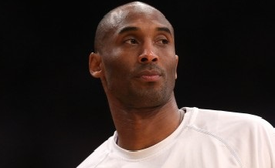
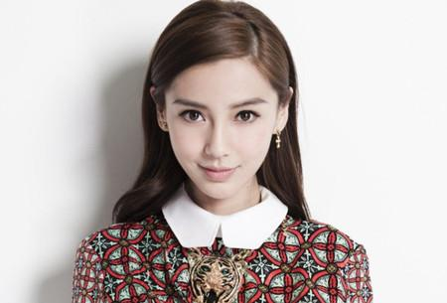
Goal
Design a good skin detection algorithm.

Slide 3
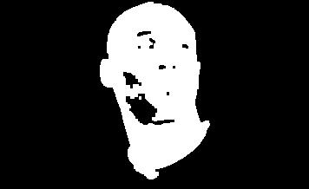
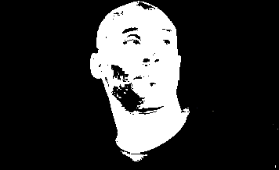
Flow Chart
356*218(不一定要跟我裁的大小一樣) 24bits bmp
HW1
HW2
Skin detection
Morphological image processing

Slide 4
Skin Detection
自行survey paper
Color space 候選: RGB, YCbCr, HSI,…
偵測的rules為何?
因為不同人種會有不同膚色分布特性,因此detection rules需考量此部分.

Slide 5
Morphological Image Processing
Goal: 使人臉區域完整,人臉內部無空洞,外圍輪廓接近真實輪廓.
Method: Dilation, Erosion,…(不限方法)

Slide 6
Grading Policy(1/2)
Code and demo(70%)
HW1(40%)
HW2(30%)
HW1&HW2 output皆為圖片.
Demo時我會在使用其它兩張圖片作測試.
Use in C/C++ only, Matlab or OpenCV is not allowed.

Slide 7
Grading Policy(2/2)
Report(30%)
The report should include:
流程圖
實驗結果
分析比較
Reference(需含參考的paper)

Slide 8
Due Date & Demo Schedule
Demo Date: Tuesday Dec.19 or Wednesday Dec.20
Demo time: 14:00 or 18:00 at E1-214-1(@VCLab)
The domo schedule will be announced at the TA webpage.
You should send your project and report to LMS before Dec.19, 13:30.
上傳檔名格式: 學號_姓名,未依規定者扣5分.

Slide 9
NOTE
The TA will use another image to test your code.
Do it yourself.
No delay!!!(If you have special case, please send email tell us early.)
You still can get some grades when you fail to operate in demo(I will give grades according to your code).
The details will be announced on our course website.
(http://140.115.154.40/vclab/html/course/DIP2017.html)

Slide 10
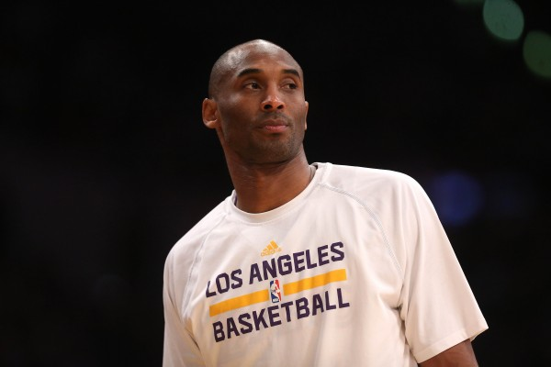

Reference
Kobe載點:(由於載下來為600*400,請自行裁剪如右下圖,重點是不要有右下角手臂那段)
http://img.ltn.com.tw/Upload/sports/page/800/2015/01/16/phpKTrfMs.jpg
AngelaBaby載點: https://img.cnread.news/uploads/20170524/DA/DA54371F00DCw450h305.jpeg

